Slide 1
Programming Assignment
Cellular Automata

Slide 2
Cellular Automata
Cellular automata provides a simple way to model populations.
By modification of input variables such as the rate of food replenishment, vastly different models are generated.
From a simple set of rules, cellular automata can produce extremely complex results, including self-replicating structures and transferrable data.

Slide 3
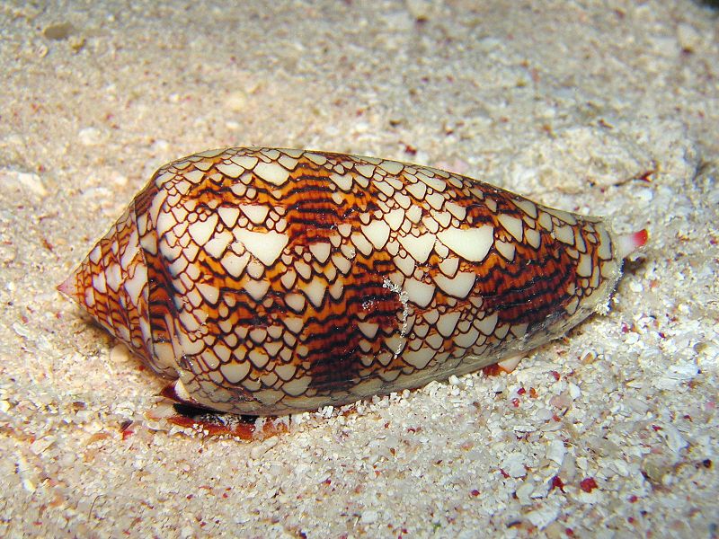
Patterns of some seashells are generated by cellular automata.

Slide 4
Introducing our animals
Animals exist in an X by Y field

Slide 5
Introducing our animals
The field has food in it.

Slide 6
Introducing our animals
Animals eat in a radius about their position.

Slide 7
As animals eat, the food supply goes down.

Slide 8
Introducing our animals
Over time, the food supply regrows.

Slide 9
Introducing our animals
If an animal has enough food, over time it will create offspring around itself.

Slide 10
Introducing our animals
If there is insufficient food nearby, Animals will die.
xx

Slide 11
Some simple rules
Animals can be alive or dead
Animals need to eat at least a minimum amount food to survive
An animal grazes in every place one unit away from the position in which it was created
An animal eating food reduces the amount of food
The grazing area of animals can overlap
Food regrows at a constant rate
If there is space, an animal will breed
Animals can breed up, down, left or right

Slide 12
Sample Automata Eating rate: 1 Regrowth rate: 2

